Slide 1
The 1990s
The Networking Nineties

Slide 2
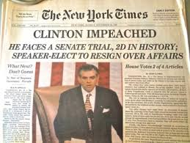
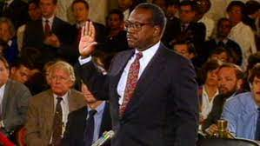
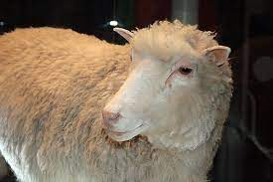
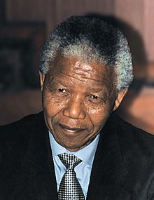
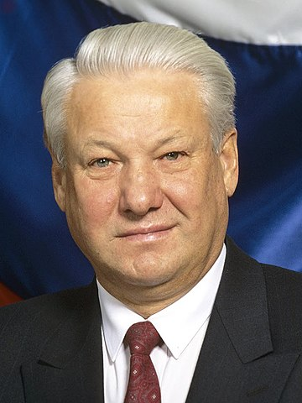
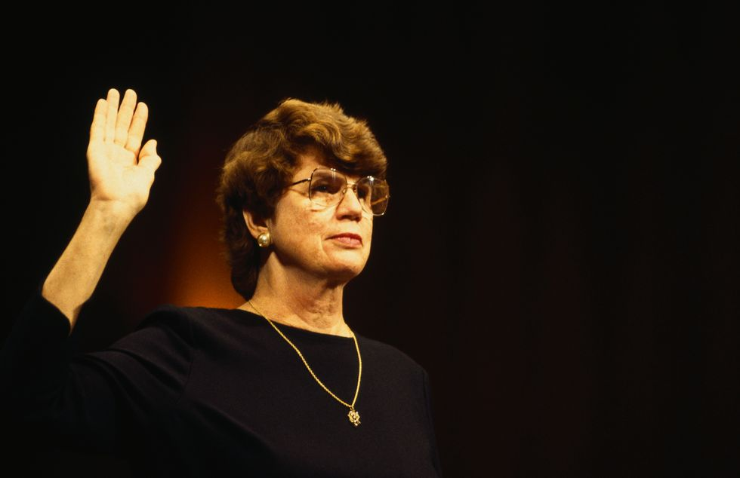
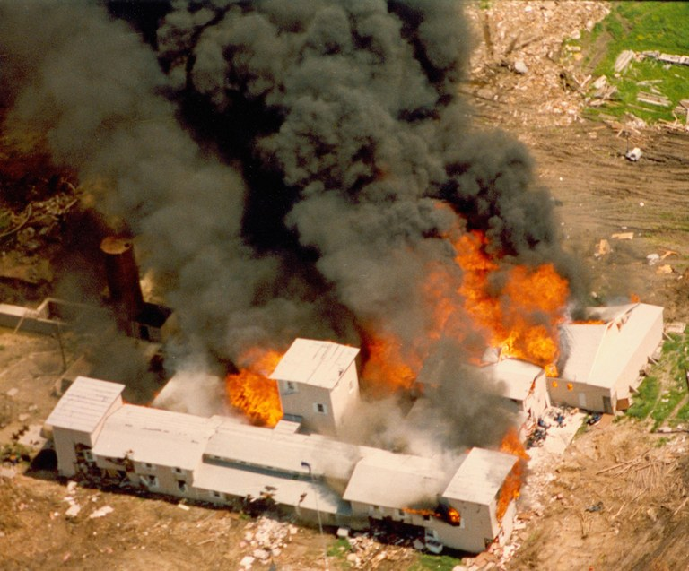
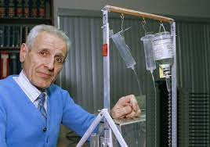
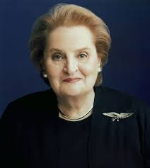
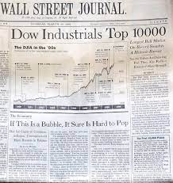
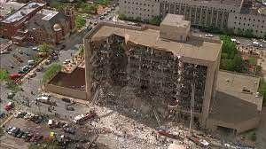
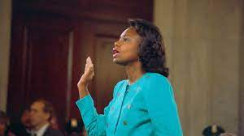
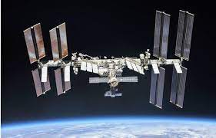
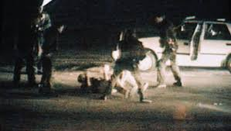
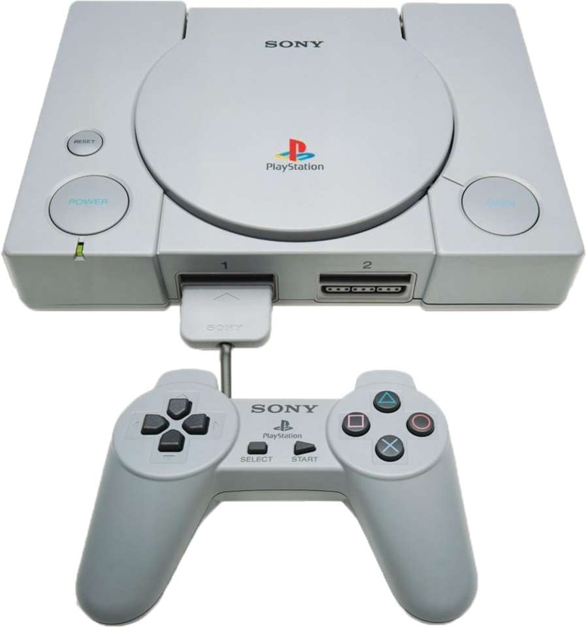
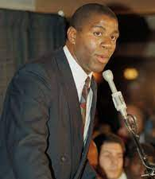
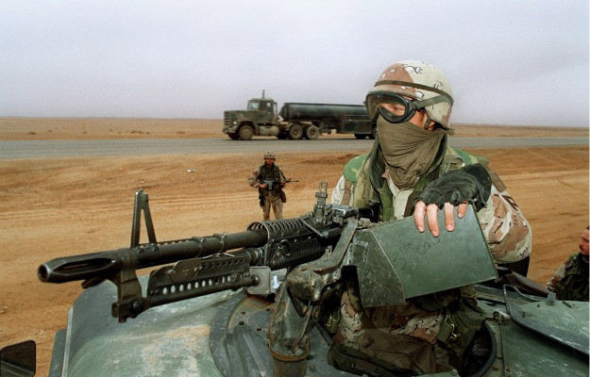
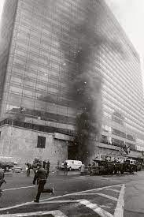
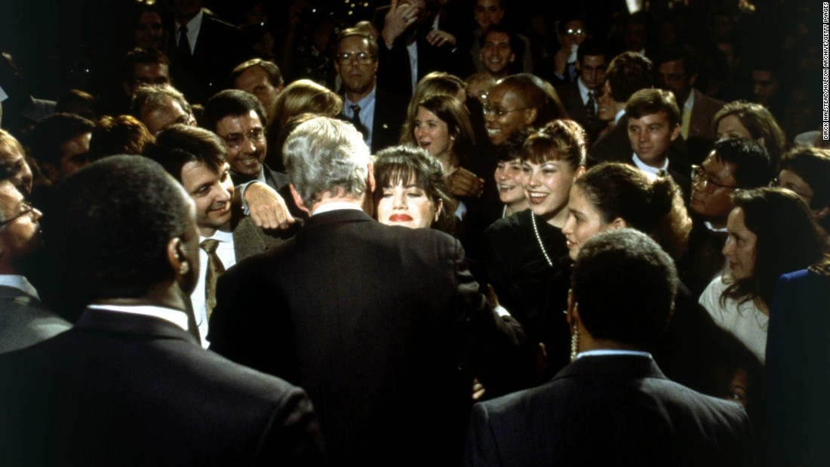
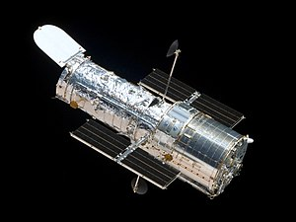
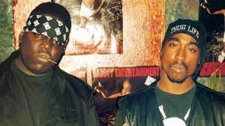
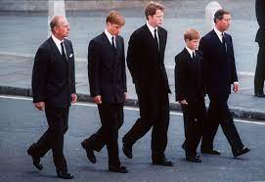
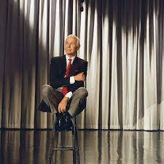
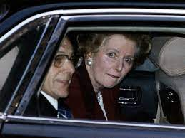
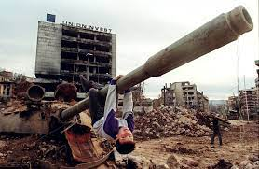
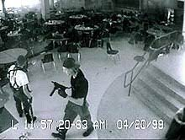
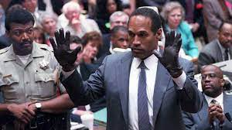

Slide 4
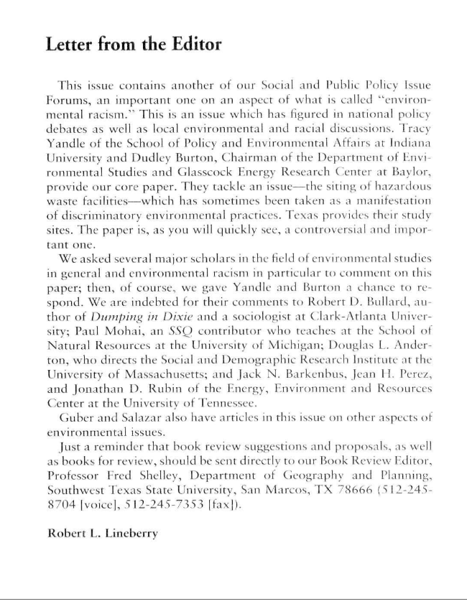

Slide 5
Year | Meeting Themes
1990 | Into the Twenty-First Century: Public Policy, Social Systems, and Patterns of Living
1991 | Global Change: Investigation, Understanding, Survival
1992 | 1492-1992: New Worlds, New Directions, New Challenges
1993 | The Social Sciences: Agents for Change
1994 | Multiculturalism and Societies
1995 | History and the Social Sciences
1996 | The Social Sciences and the 21st Century
1997 | Looking Backwards: The Social Sciences View the Twentieth Century
1998 | Evolution, Devolution, or Revolution: Past, Future and the Social Sciences
1999 | Small Planet: The Southwest and a Changing World

Slide 6
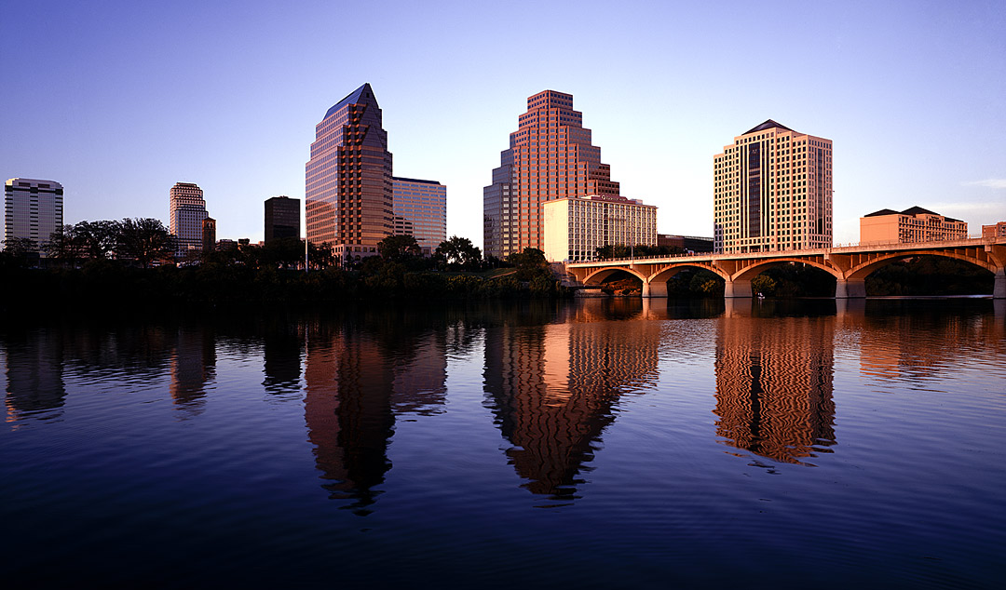
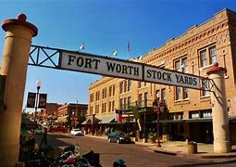
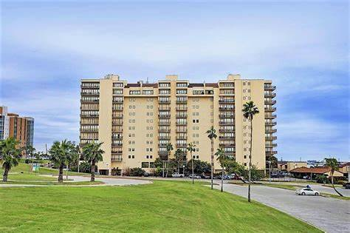
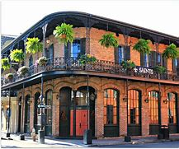
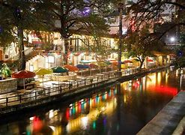
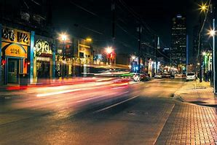
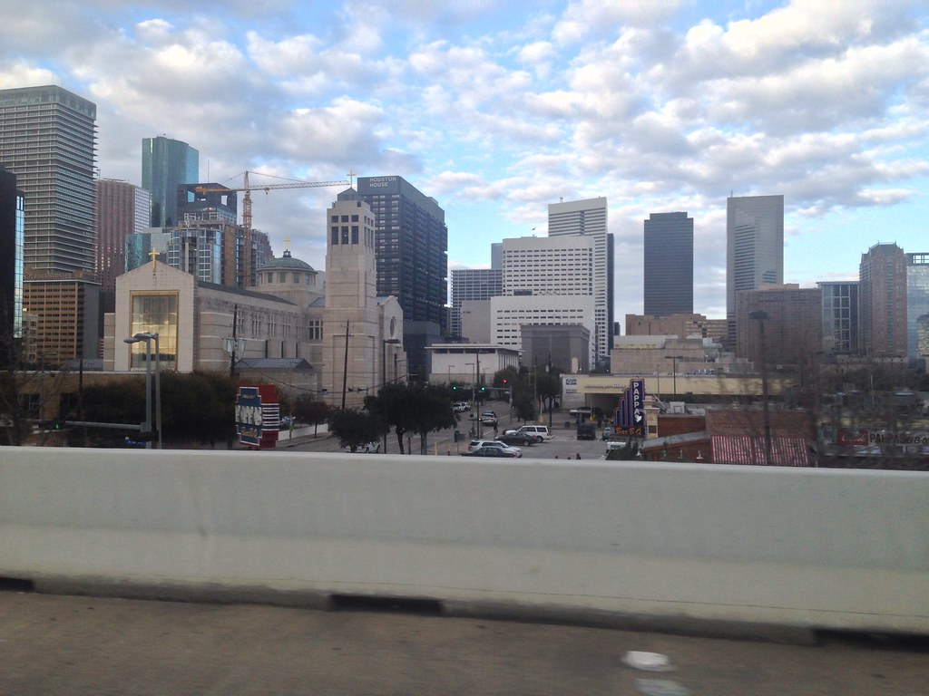
1990s Conference Locations
Austin
Fort Worth
Corpus Christi
New Orleans
San Antonio
Dallas
Houston

Slide 7
Association Presidents During the 1990’s
1990 | Leon C. Hallman | Geography | Stephen F. Austin State University
1991 | Amos Simpson | History | University of Southwestern Louisiana
1992 | Ruth S. Jones | Political Science | Arizona State University
1993 | Kathie Gilbert | Economics | Western New Mexico University
1994 | Charles M. Bonjean | Sociology | University of Texas
1995 | Elizabeth Esterchild | Women’s and Gender | University of North Texas
1996 | Cary D. Wintz | History | Texas Southern University
1997 | Robert L. Savage | Political Science | University of Arkansas
1998 | Clint Johnson | Economics | University of Central Arkansas
1999 | Larry Lyon | Sociology | Baylor University

Slide 8
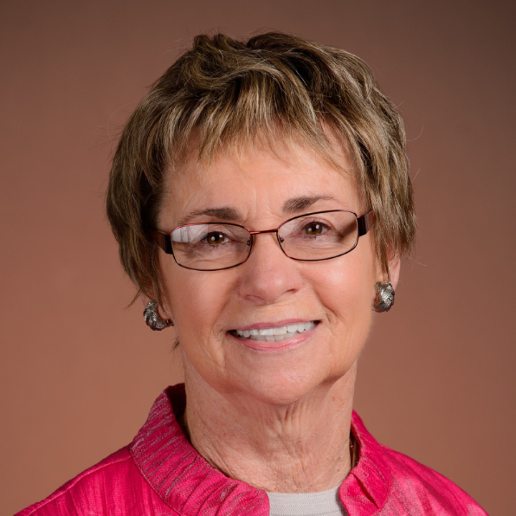
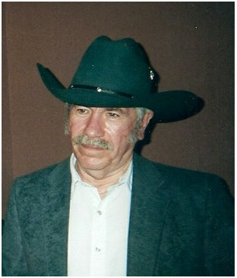
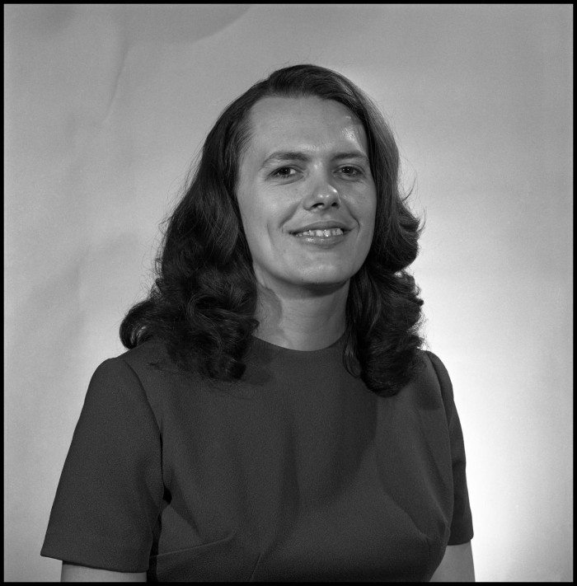
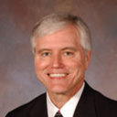
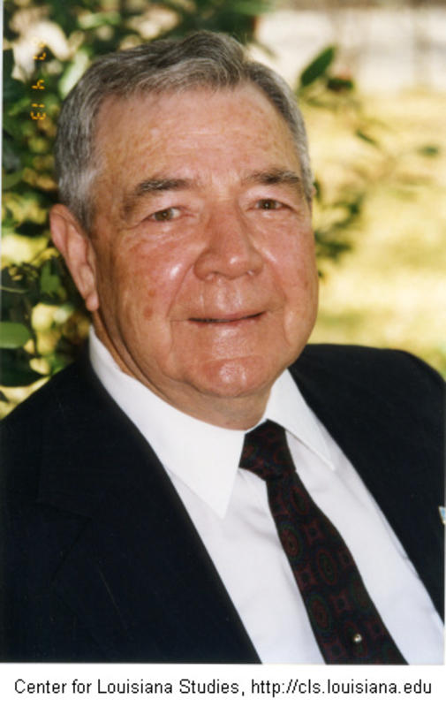
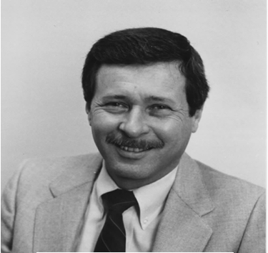
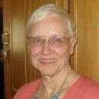
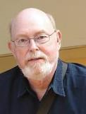
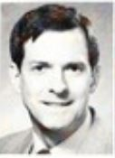
1995: Elizabeth Esterchild
1992: Ruth S. Jones
1996: Cary D. Wintz
1993: Kathie Gilbert
1999: Larry Lyon
1991: Amos Simpson
1998: Clint Johnson
1990: Leon C. Hallman
1994: Charles M. Bonjean
1997: Robert L. Savage
SSSA Presidents
1990-1999

Slide 9
